Slide 1




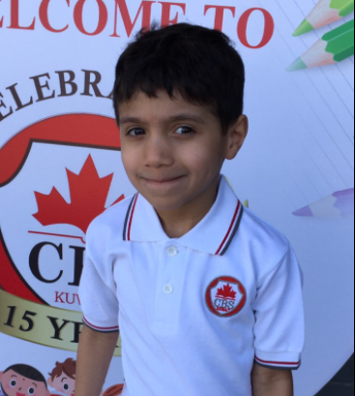
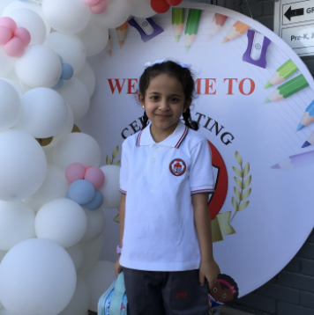
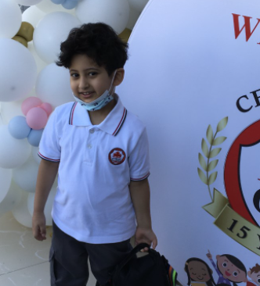
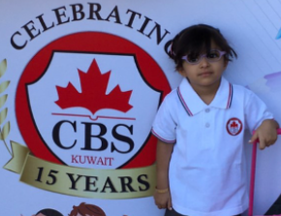
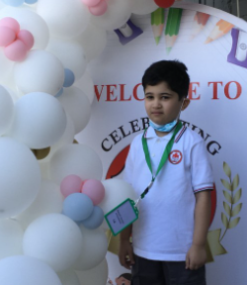
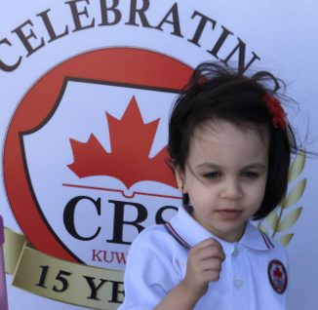
CBS EXPRESS
October 2021 Vol: 7 Issue: 1
Welcome back to school! Over the past month, we have kicked off the academic year with online learning but gradually also welcomed back our students for classroom learning. Special days appear throughout the calendar year as a way and means to promote collaboration and develop community. During the month we focused on respect. Be sure to check the school calendar and/or the list of upcoming events on the last page of the newspaper for our next special day.

Slide 2
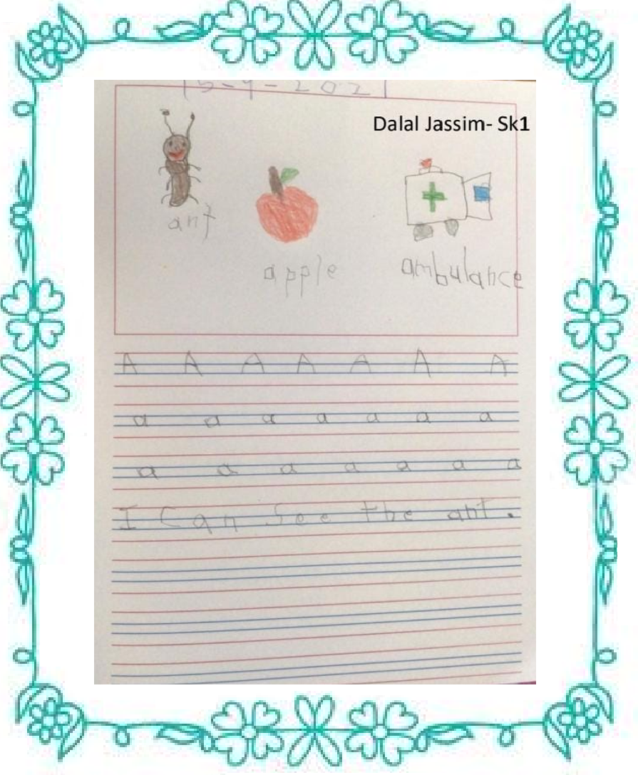

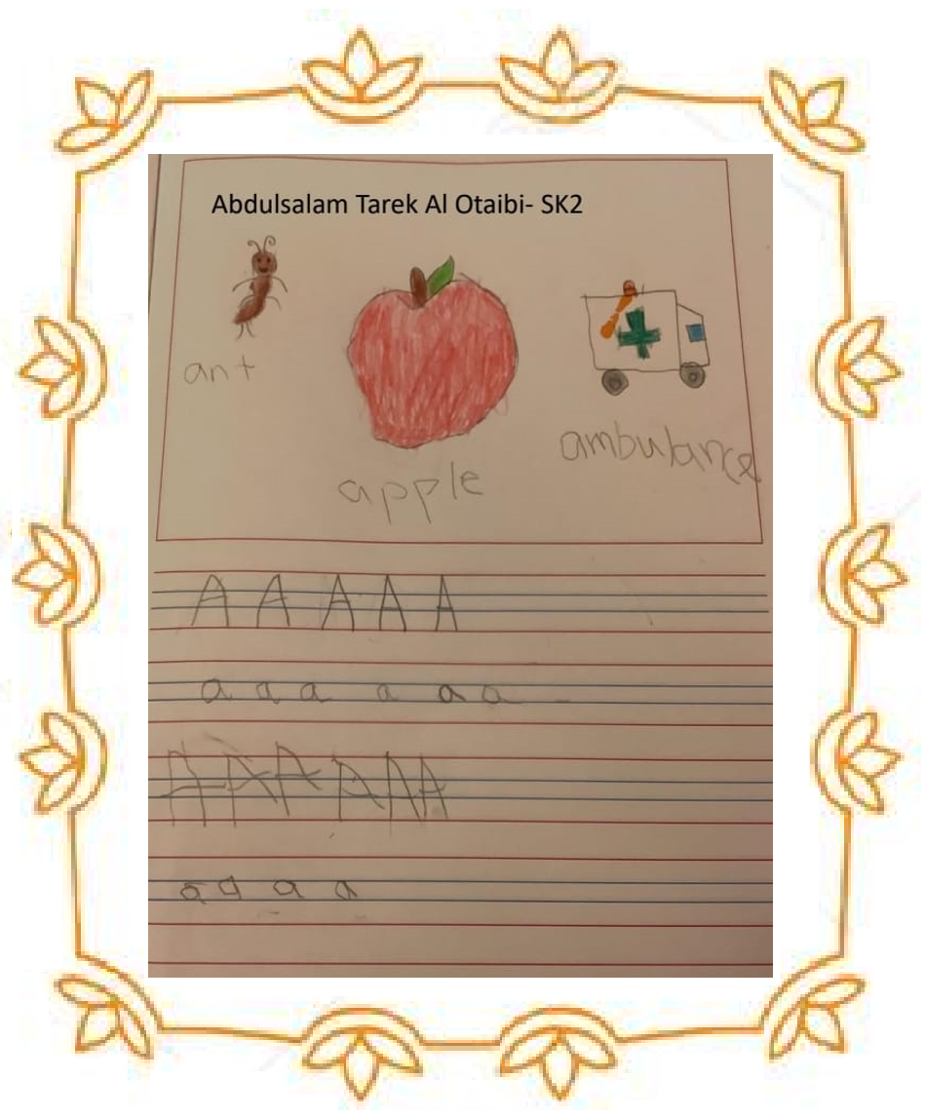
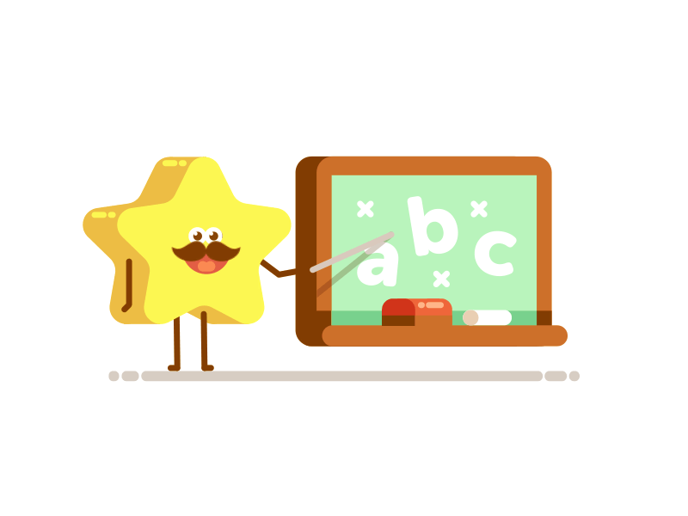
2
CBS EXPRESS Vol: 7 | Issue # 1
CBS Little Artist
Dalal Jassim- SK 1
Abdulsalman Tarek- SK 2

Slide 3

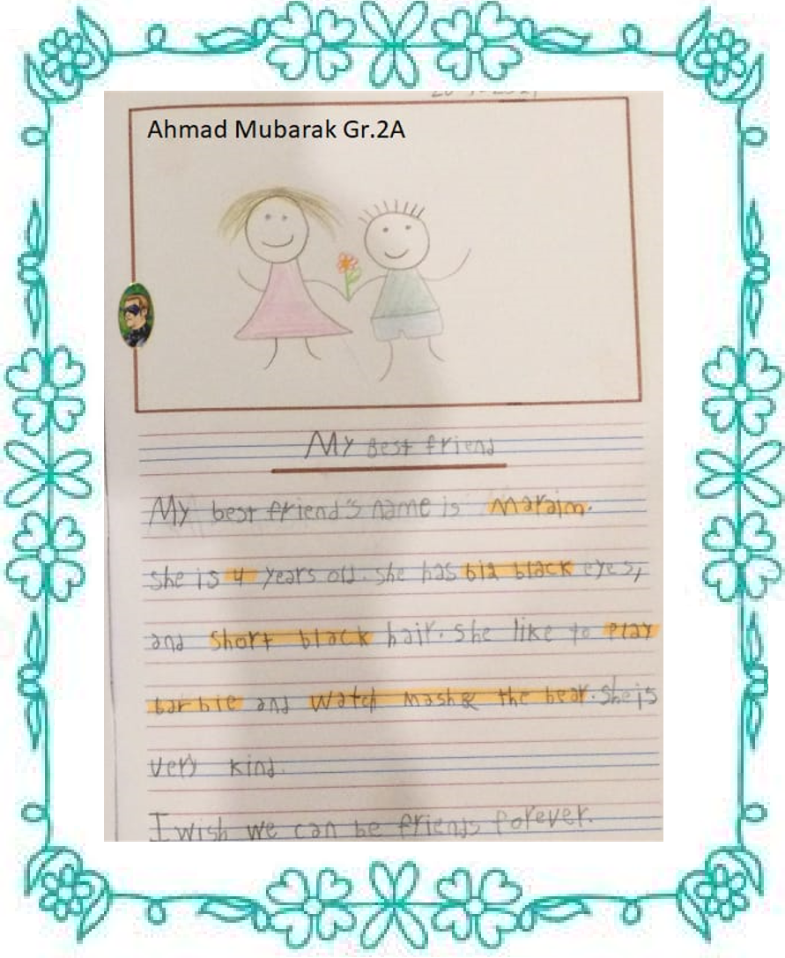
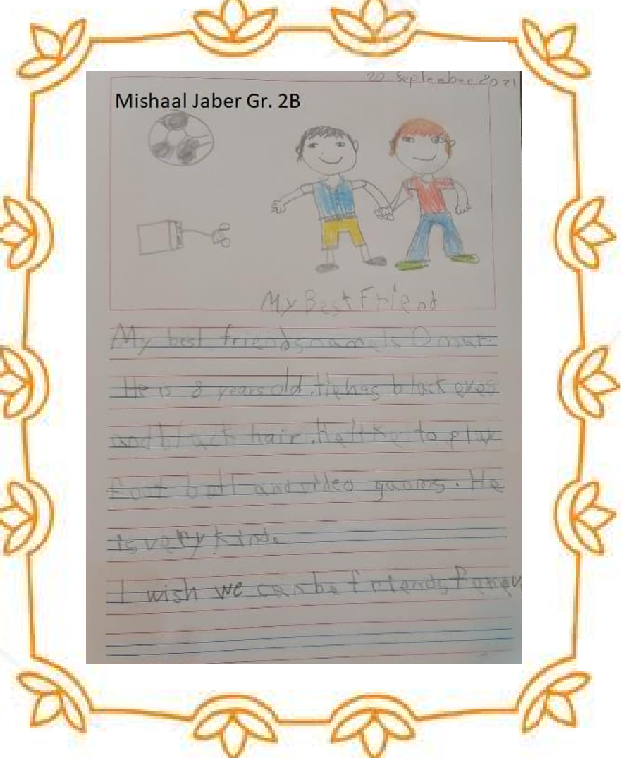
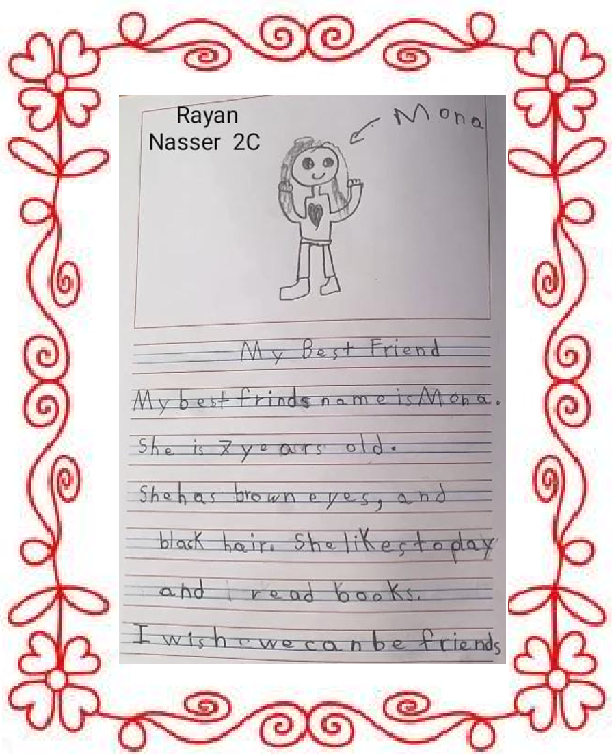
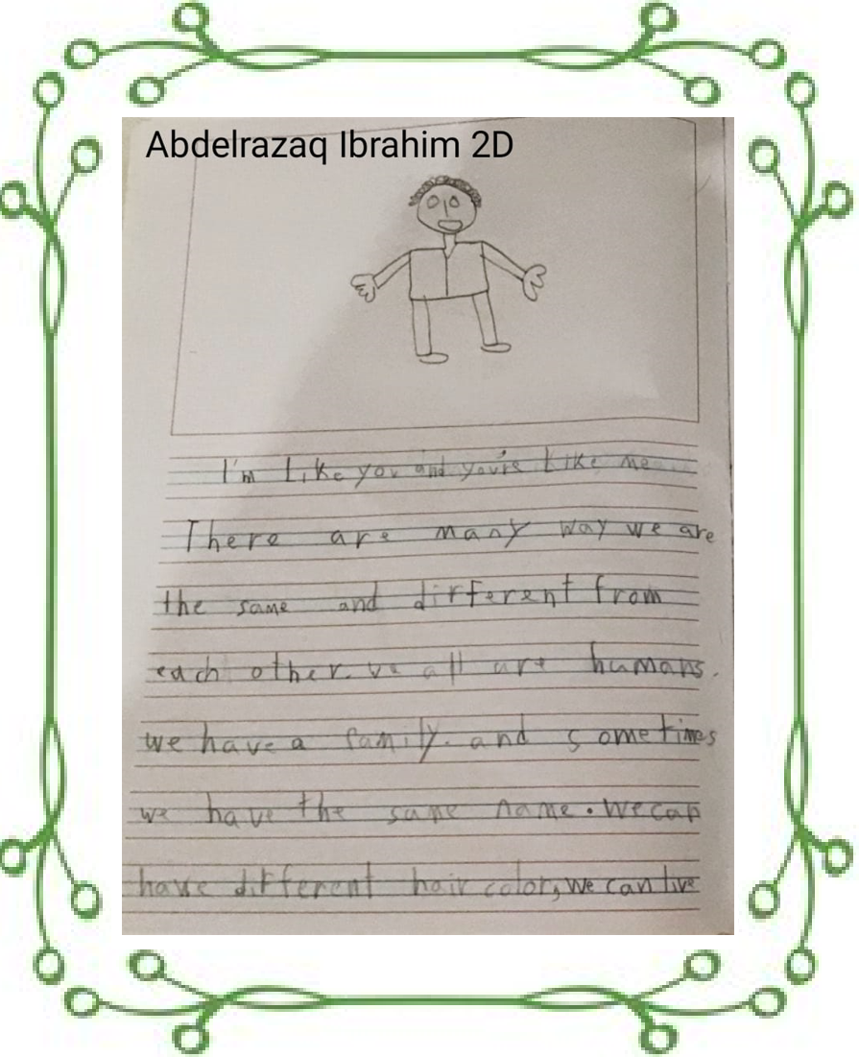
3
CBS EXPRESS Vol: 7| Issue # 1
Grade 2- All about me writing
Ahmad Mubarak– Gr 2A
Mishaal Jaber– Gr 2B
Rayan Nasser– Gr 2C
Abdelrazaq Ibrahim– Gr 2D

Slide 4



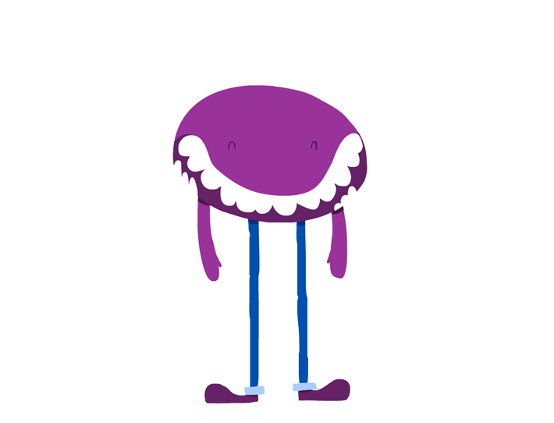
CBS EXPRESS Vol: 7 | Issue # 1
4
Grade 4- Poetry
Monster
Weird, disgusting
Eating, killing, shouting
Jumping, destroying, scared, sliding freak
Layan Rayed 4A-A
Monster
vile, hideous
growling, disgusting, revolting
Noisy, tense, scary
Beast
Mayyar Fahad 4A-A

Slide 5
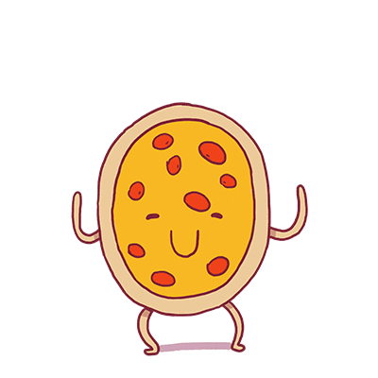


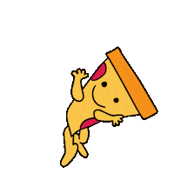
5
CBS EXPRESS Vol: 7 | Issue # 1
Grade 4- Poetry
Pizza
Pizza, pizza, pizza
I ordered a pizza
I love pizza
Oh! You don’t love it?
All of us like pizza
Meow likes pizza.
Ring! Ring!
My phone is ringing
Oh, it’s pizza
I will enjoy my pizza
Grrrr! my stomach is growling
I need pizza right away
I ordered one with pepperoni
Tick, tock, tick, tock
Time is running so slow
When pizza finally arrived
It screamed at me: “eat me, eat me!”
Abdulaziz Mohammed 4
Bani Bnayan Al Mutairi 4A-B

Slide 6

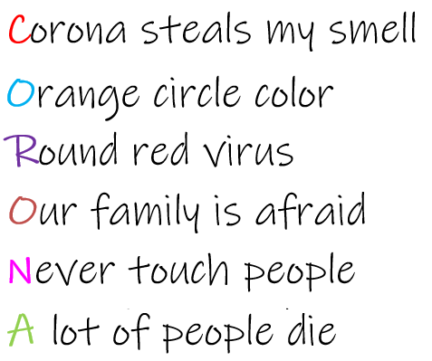

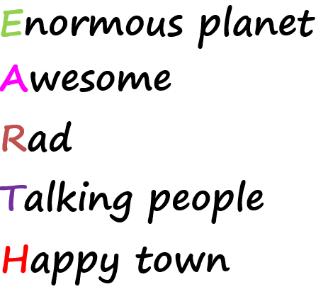
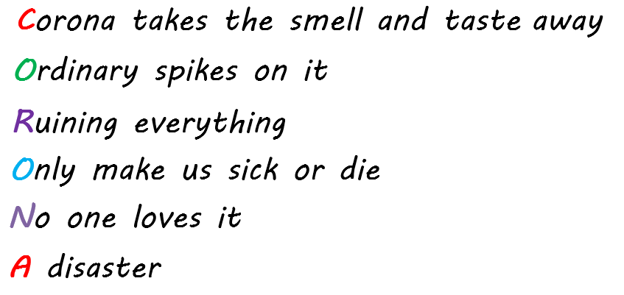

CBS EXPRESS Vol: 7 | Issue # 1
6
Grade 4- Poetry
Amer Ahmad 4B-A
Mohammad Salman 4B-B
Salman Dawoud 4B-A

Slide 7
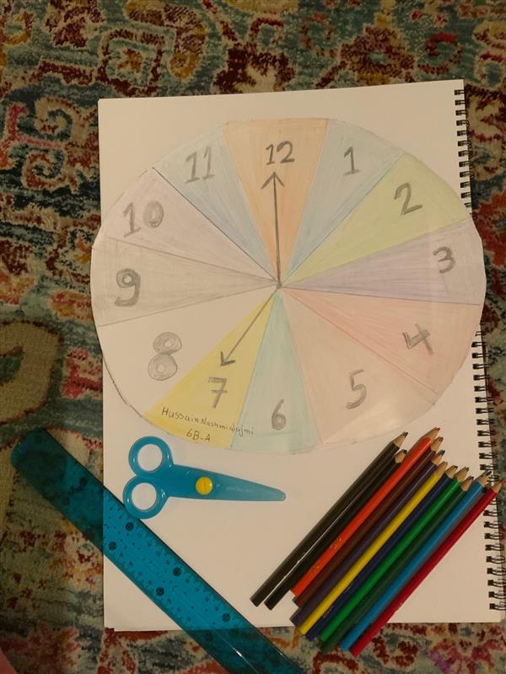
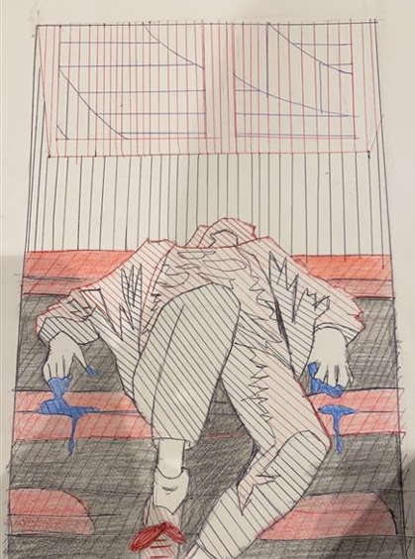


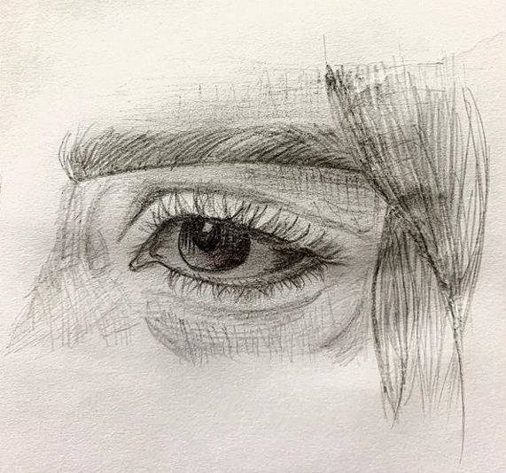
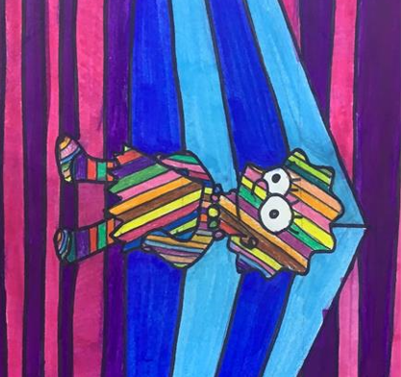


7
Art Corner
CBS EXPRESS Vol: 7 | Issue # 1
Hussain Namshi 6B
Al Jouri Hussain Gr.8
Asma Yousef Gr.8
Hajer Hussain Gr.10

Slide 8
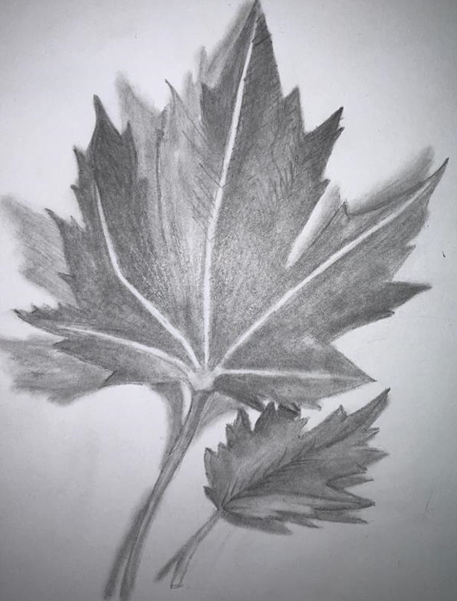
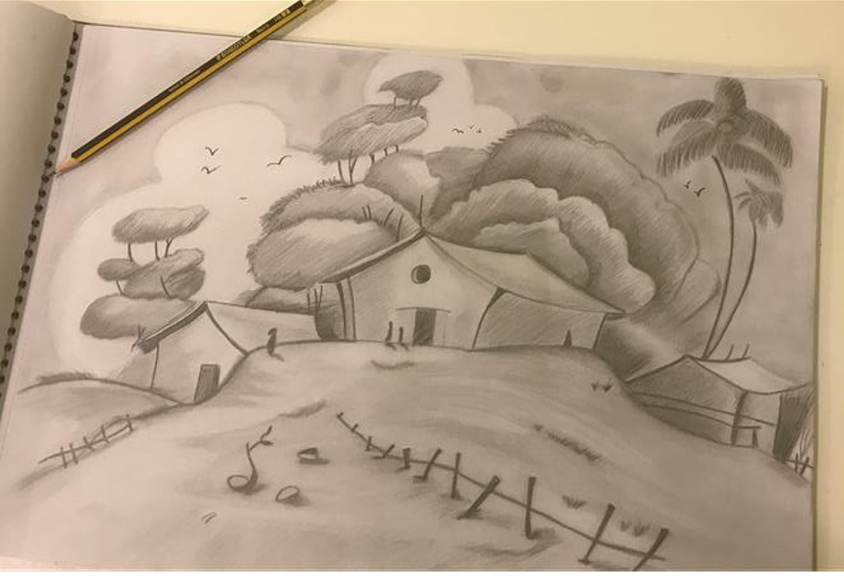


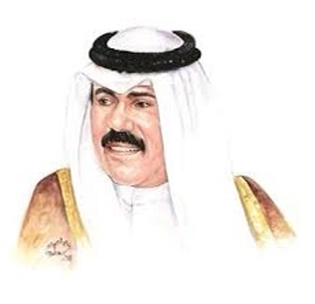
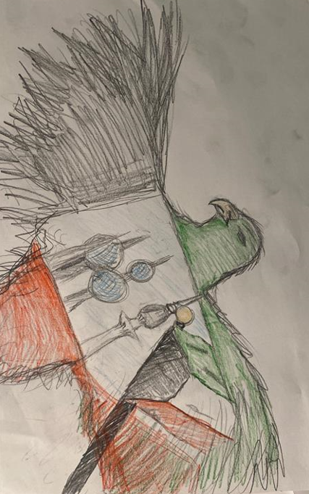


8
Art Corner
CBS EXPRESS Vol: 7 | Issue # 1
Fatema Abdullah 10A
Khaled Faisal 12B
Fahed Khalid 12B
Ahmed Hamad 12B

Slide 9

Grade 6 Writing
CBS EXPRESS Vol: 7 | Issue # 1
9
THE GREEN LION
In the jungle, there was a lioness giving birth to her new baby in the lion’s area of the jungle. After she gave birth, she went to see her baby cub, and to her surprise, her baby was green!
She went to ask her other kids if any of them had colored on their new brother. They all said that they were with the tiger’s kids playing in the middle of the forest. The lioness went to the lion and told him about the green baby cub. The lion did not like his baby and thought it was hideous and disgusting. He also told his wife and the green cub aloud that he would have to fend and protect himself and that he was on his own.
After one year, the green lion learnt to hunt and fend for himself. He was able to find shelter under the trees. Soon he was a twelve-year-old predator who could fight and hunt down his prey. However, what bothered him was that everyone looked at him as if he was a monster. Since he was twelve now, he would have to start going to school. On his first day, he walked in, and everyone started staring at him. He quietly walked into the class and sat down. After him, everyone else walked in. In the middle of the class, a person who looked like him entered the class and said he was sorry he was late. He wondered why that stranger looked so similar. He thought to himself that he would ask his mother about it.
When the mother came to pick the children up, the stranger started walking toward her, but she told her children to hurry up and go home when she saw him. He started following her very carefully, and when they got home, he felt a group of people snatch him. They started to hit him and then they ran away. He thought it was about his skin color because all he saw was orange and yellow lions. Suddenly, he heard a whisper. Once he turned, he saw a group of pink, blue and green lions in front of him. They said that they were a rare breed of lions because they were of an unusual color. They further revealed to him that they had a plan to kill the king and whoever does it first gets to be the forest king. They wanted to kill the king as he thought their breed was different and hideous and did not belong in the jungle.
After hearing the plan, the green lion went home and started building a weapon. He went over to the lion king’s house and killed him with his weapon at the right opportunity.
The moral of the story is to accept everyone for who they are and that everyone is unique.
Samera Bader Al Tameemi-6A-A

Slide 10
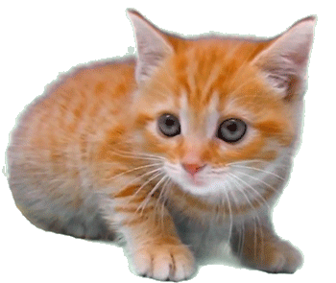
Grade 6 Writing
CBS EXPRESS Vol: 7 | Issue # 1
10
THE POOR KITTEN
One day Maria was on a bus coming back from school to go to her home. When she stepped out of the bus, she heard a baby kitten crying in the corner. It seemed like the kitten had lost her mother. Maria felt extremely sorry for the kitten and decided to adopt the baby kitten. After a few weeks of Maria taking care of the kitten, the kitten was healthy. But, on the other hand, there was a guy named Liam. Liam was the boy who adopted the kitten and her mother when they were stray cats. Liam kept on crying for a week for he had lost the kitten.
Soon he came up with a fantastic idea. His idea was to print posters with his kitten's picture and number on it, then post them on walls and poles. Two days later, the poster was ready, and he printed a few copies of it.
Many days passed, but there was no sign of any callers or information about the lost kitten. Eventually, Liam got tired and finally gave up. The same evening Maria decided to go for a walk, and while she was walking, she saw a poster nearby and went closer to have a better look at it.
Maria was shocked to see that the kitten she adopted was someone else's pet. Maria called the number as soon as possible and informed Liam that she had his kitten. Liam was thrilled to hear the news. So, they decided to meet up the next day at Liam's house with the kitten. When they met the next day, Maria gave the kitten back to the owner. She was a little sad but was happy that the kitten was with her owner again, and at last, she reunited the mother and the kitten.
Finally, both Maria and Liam were happy and became great friends.
Moral of the story: Always help others, whether it is animals or humans.
Roshaney Khan Amin 6

Slide 11

11
CBS EXPRESS Vol: 7 | Issue # 1
Grade 8 Writing
Character's Voice
Memoir (Eleven) Rachel (Student)
*Wakes up and yawns* oh, today will be such a fantastic day; it is my birthday, and I am finally eleven years old, but I still do not feel 11.
Oh well, I need to go to school. "Mum, I am ready for school", I shouted. "Okay, Honey, do not forget your lunch". "I will not, mum."
Argh, the first period is Math. I hate math. *Takes a deep breath* okay, I can do this in just 30 minutes. Everyone took their seat, then Mrs. Price made an announcement, WHOSE IS THIS RED SWEATER? The whole class sat in silence until Silvia said that I owned it. "But Mrs. Price it- it is not mine." But she did not want to hear anything and asked me to wear it, claiming that she saw me wearing it once before. However, it was not mine! I scooched it over, but Mrs. Price noticed and screamed at me. I got scared, and I wanted to burst out into tears. Then she forced me to wear it, and I could not handle it anymore. I burst out in tears until they were all gone. Then Philips came and said that it was hers' and I immediately took it off and gave it to her. I just waited for the day to end and went home. I thought there would be cake and papa and mama would be there, and it would be fun. I finally got home and had a wonderful time.
By: Abdulaziz Faisal

Slide 12

12
CBS EXPRESS Vol: 7 | Issue # 1
Grade 8 Writing
Sylvia Saldivar (Mean Student)
Thank goodness Mrs. Price believed me when I told her that sweater belongs to Rachel, and now Mrs. Price is sure about whose sweater that was, as she remembered Rachel wearing it. But Rachel vehemently denied it when Mrs. Price put the sweater on her desk, and I could see the annoyance on her face. Well, I may be mean to Rachel, but the sweater was hers. Why cannot she accept that the sweater belongs to her?
By: Abdullah Ahmed Al Bader
Mrs. Price (Teacher)
Oh, the same class again. "Hello, students, now whose is this. Whose is this red sweater? I am tired of this. It must belong to somebody. Ah, thank you, Sylvia. Of course, it is yours. What do you mean, Rachel? I remember you wearing it once. Just wear it!"
"Now let's move to page 32 everybody math problem number 4".
"Rachel!!!! Now that is enough, wear the sweater, or I will kick you out of class. Rachel now put that sweater on, and no more nonsense. Now Rachel!" argh! This girl will kill me one day.
Lunchtime everyone. What do you want, Phyllis? Oh, okay, Rachel, take that sweater off and give it to Phyllis.
By: Salman Jabar

Slide 13
CBS EXPRESS Vol: 7 | Issue # 1
13
Grade 10 Writing
Happiness
What is happiness? We can ask hundreds and thousands of people, and each of them would give different answers. One would say happiness is to be with a loved one, the second would say happiness is stability, and the third would say happiness is unpredictable. For someone, to be happy is to have a lot of money while for others to be popular. Overall, there are plenty of different understandings of happiness. We must appreciate every moment in our lives. We will never know when the end will come or what we have in store for us soon.
I consider happiness harmony and peace when my family and friends are healthy and happy as well. I recognize that they are all dear and important to me and understand me. I know that they will support me in any situation doing everything that depends on them. In return, I am also ready to do much for them. What we do for others, helping them when they need our help, advice, or support and getting enough appreciation, is happy because in helping others, we are doing something incredibly significant and necessary. Not all people get enough joy in life, so that some people would appreciate a small act of kindness. Another important way to feel happy is to stop thinking about yourself. Think about what you can do for the community. Spend time thinking about how you can contribute to society; it does not matter how much it is, do it. It is for your happiness and betterment of the life of deprived people. Developing a habit of satisfaction and gratefulness needs time. It will open the doors of happiness to you that you have not even imagined ever in your life. Another thing that can make you happy is spending time connecting with nature. Take out time and enjoy the moment.
Happiness is not something that is given. Every person has happiness inside. True happiness is not in owning valuables, money, or any other kind of possession. It lies within us.

Slide 14

CBS EXPRESS Vol: 7 | Issue # 1
14
Grade 10 Writing cont'd..
Whether rich or poor, upper caste or lower caste, we all have the same potential to experience happiness in our life. Moreover, it is never too late to become happy. We can motivate ourselves and others to be happy. A smile here and there or a simple greeting; everyone chooses and prefers various sources. It is of immense importance for people to enjoy precious moments, even the most insignificant ones. It might be a cup of coffee in the morning, daily yoga or reading a newspaper. Whatever the reason, there should always be a reason to smile and be happy.
Sometimes people are so lonely that they start to doubt themselves and wonder why they are so depressed. The truth is, you should look for friends and start looking around for the good things in the bad. Find something positive in the negative. Material values are not an accurate measure of happiness. Happiness is the ability to be optimistic even with difficulties and the ability to overcome them.
Also, all things should be life lessons for us. Instead of us thinking that we were being lectured about being stupid, think of it as a life lesson which you could benefit from in the future. Another important way to feel happy is to stop thinking of your comforts. Think about what you can do for the betterment of society. Spend time thinking about how you can contribute to society and the environment. However small it is, do it. It is for your happiness and the betterment of the life of deprived people.
We need to appreciate every moment in our lives, remembering that happiness is within us. Time passes, and we are getting hurt because we did not enjoy the time when we had a chance. Therefore, living in peace and harmony with others, helping those who need your help, and avoiding things that you would regret in future are paramount ways to find happiness and make others happy.
By: Gala Mohammad

Slide 15
15
Grade 12’s Channel
CBS EXPRESS Vol: 7 | Issue # 1
Student Council
Why should teenagers be taken seriously?
Shouting, misbehaving, disrespecting their elders, not listening, that is all the teenagers do, right? All they do is act reckless and irresponsible; have you ever wondered why, though? Everyone always complains about how teenagers behave, and therefore never take them seriously. Still, few people put in the effort to find out why teenagers act the way they do. Research shows that teenagers are the most neglected and misunderstood age group. They tend to be brushed off when it comes to discussing their emotions and ambitions, therefore causing them to act out in an unhealthy manner. We all know that teenagers will unavoidably be the future generation, so imagine how powerful our future generation could be if we started taking them more seriously. Teenagers act the way they do for numerous reasons, and the older generation needs to stop misconstruing teenagers. If the older generation takes teenagers more seriously, teenagers will feel more respected and perceived, leading to a more sustainable society.
Why do teenagers act the way they do? One of the most common reasons why teenagers act the way they do is because they are not taken seriously by adults. They are not taken seriously; therefore, they feel unheard and get overwhelmed, leading them to shout and act out. Research shows that affectional neglect may have devastating consequences, including failure to thrive, aggression, depression, low self-esteem, running away from home, and a host of other emotional disorders. As we all know, these things should not be taken lightly and avoided at all costs, yet no one is trying to prevent it; if anything, most adults enable it. Therefore, it makes no sense for adults to ridicule and underestimate teenagers because of their actions when their very own actions are the consequences of the way that adults treat them.
The older generation needs to accept the inevitable. Teenagers, at some point, will grow up and rule countries, armies, civilizations, etc. No matter what adults may think, society has changed. Teenagers are not like before; teenagers nowadays have access to the internet; they know all about the horrible tragedies that are occurring. They know about global warming, they learn about capitalism, about racism, about all the world issues. It makes no sense to treat modern teenagers like past teenagers. Teenagers have led many protests involving gender inequality, racial discrimination, and civil rights

Slide 16
16
CBS EXPRESS Vol: 7 | Issue # 1
Grade 12’s Channel cont’d..
Student Council
I can list countless resources that claim that teenagers are the most educated, the most progressive, the least conservative and the least biased generation out of all the past generations. Finally, knowing all that, don't you think we should start encouraging teenagers to be the best versions of themselves? And not try to break them down?
How many times were you told as a kid to follow your dreams and never give up? Because I know that I was told by teachers, parents, elders, everyone in my case! But the minute I turned into a teenager, it suddenly went from 'dream big' and never give up to 'stop dreaming and act realistically'. How does it make sense for us to be told to follow our dreams but the minute we start achieving them, we are told to 'act more realistic'? It makes no sense. If anything, the teenage years are when you should start achieving your dreams and try to make your dreams a reality because we know that though teenagers are old enough to make a difference, they are still young enough to have nothing to lose. That opportunity should not be taken away from them just because people do not believe it is "realistic." Teenagers can do anything they make up their minds! Here are a couple of teenagers that changed the world!
"Joan of Arc was only 13-years-old when she led the French army in a significant victory against the English at Orleans (without any previous military experience), causing Charles VII to regain the nation in 1429. Whereas Louis Braille, a 15-year-old blind man, invented braille (the language for the blind) in 1824. Also, Mary Shelley was only 18 years old when she wrote "Frankenstein", the most classical piece of literature." So, to sum it up, teenagers are capable of anything and should be encouraged to achieve their dreams.
Long story short, at the end of the day, teenagers are still young and need validation and affection. When they do not get that, it can cause them to act immorally, yet even with all that, modern-day teenagers still manage to top the charts when it comes to the most skillful and open-minded generation. Teenagers are capable of anything and should always be taken seriously and encouraged to achieve their dreams.

Slide 17

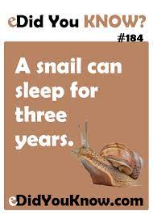




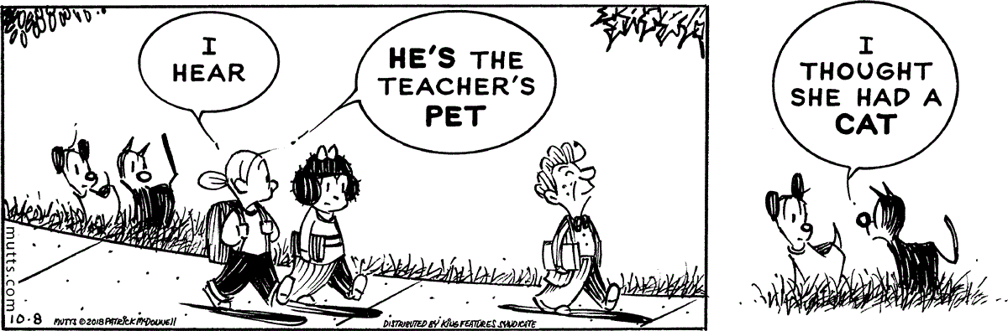
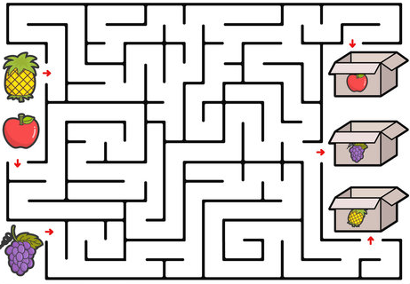
Puzzle TIME
17
CBS EXPRESS Vol: 7 | Issue # 1
pot the difference
Move the fruit to the correct box

Slide 18
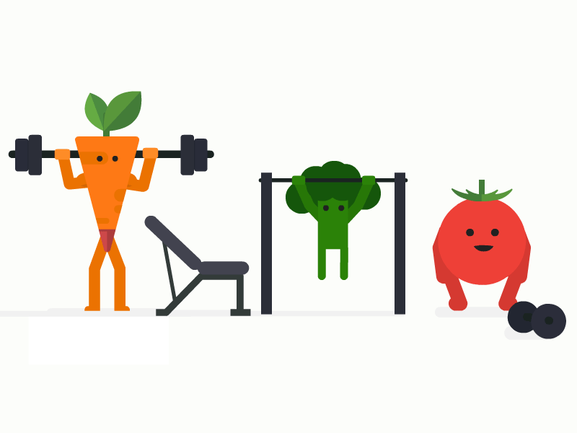

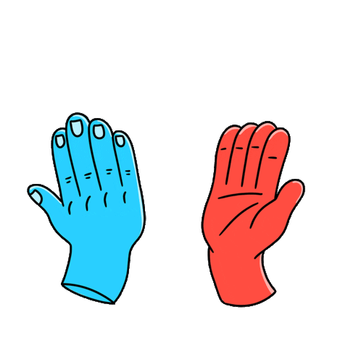
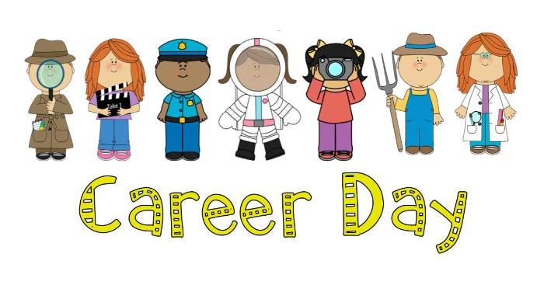

18
CBS EXPRESS Vol: 7 | Issue # 1
UPCOMING EVENTS at CBS
JK healthy living: vegetables day- Oct 10th
After school clubs begin (Every Wednesday Oct 13 - Nov 24)
Prophet's birthday – Oct 19th
Career day– Oct 21st
Assembly : Responsibility (GR 3)- Oct 21st
Gr 7 healthy living – Sportsmanship- Oct 21st
JK-SK Parent Engagement Event / EarlyBird Orientation- Oct 25th
Gr 5-6 Parent Engagement Event / LitPro Orientation- Oct 27th
Quarter 1 ends- Oct 28th
Quarter 2 begins- Oct 31st
CBS EXPRESS Editor in-Chief: Ms. Kirti. S
The First English Language Newspaper @ CBS Designer: Ms. Preeni .V and Ms. Monique

