Slide 1



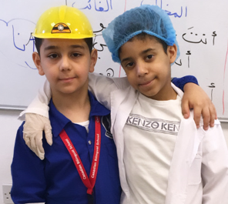
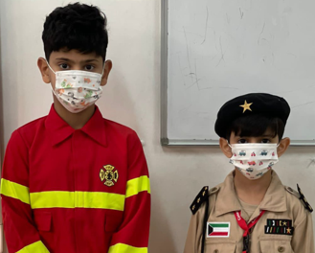
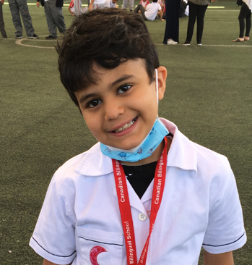
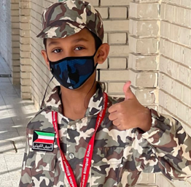
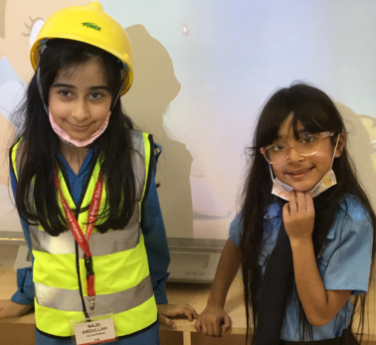
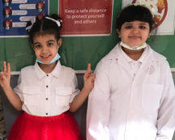
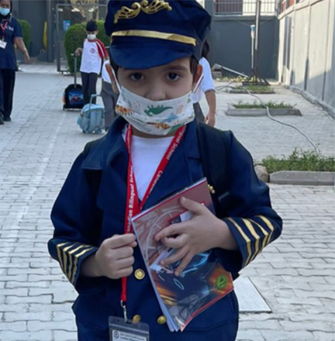
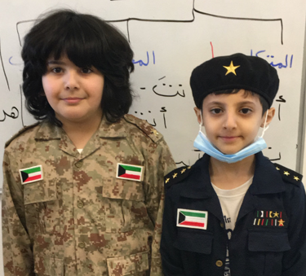
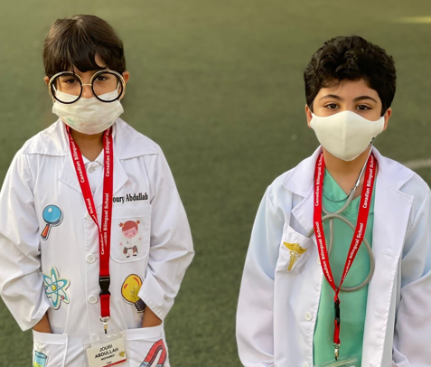

CBS EXPRESS
October 2021 Vol: 7 Issue: 2
We have been busy here at CBS the past month both academically and socially. Special days appear throughout the calendar year as a way and means to promote collaboration and develop community. Our school kicked off the year with Career Day. The students were very serious about their careers, and we saw many potential doctors, teachers, firefighters, police officers and army recruits. Be sure to check the school calendar and/or the list of upcoming events on the last page of the newspaper for our next special day.

Slide 2
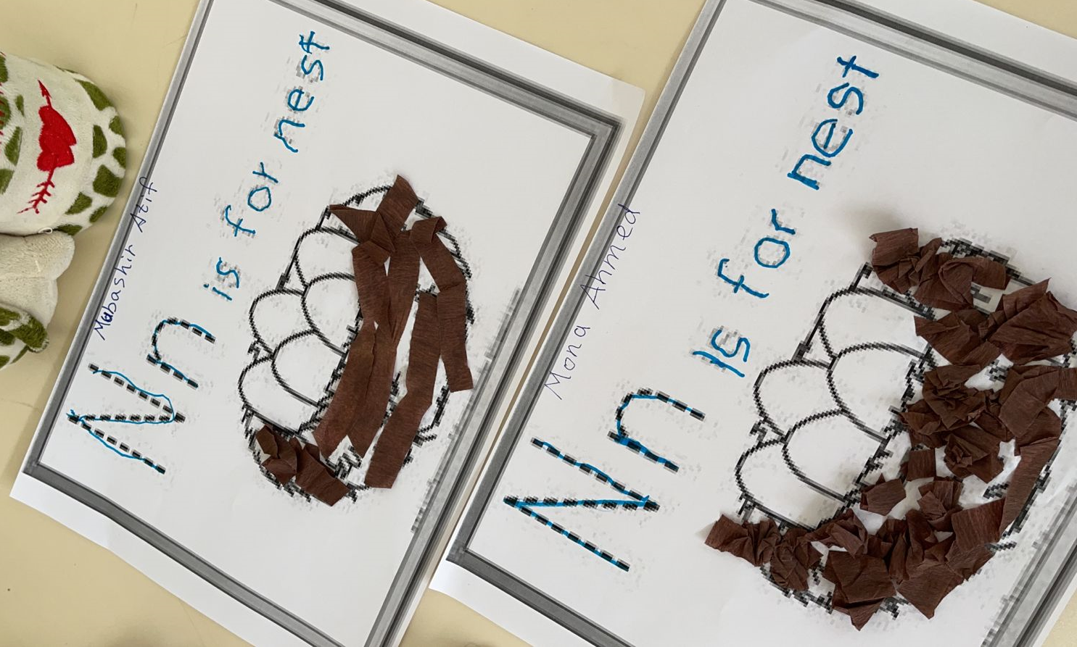
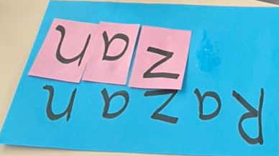
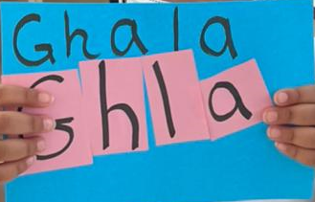

2
CBS EXPRESS Vol: 7 | Issue # 2
CBS Little Artist
Mona Ahmad
JK 2
Razan Nassar
JK 1
Ghala Ibrahim
JK 1
Mubashir Atif
JK 2

Slide 3


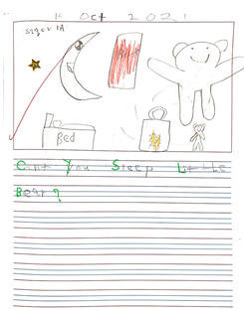
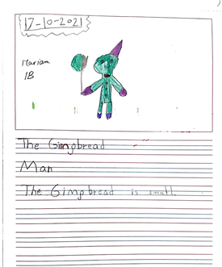


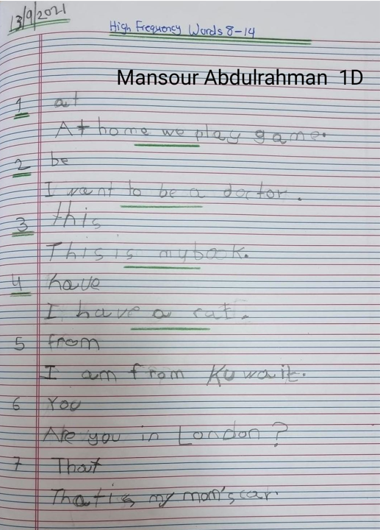
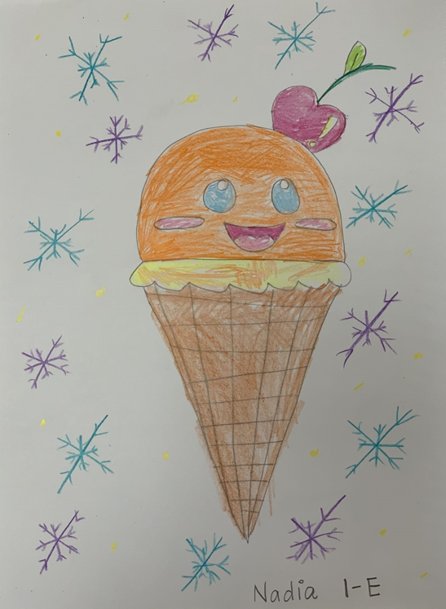
CBS EXPRESS Vol: 7| Issue # 2
3
Grade 1 Writing
Saqer Al enezi
Gr 1A
Mariam Y. Al Ali
Gr 1B
Mansour Abdulrahman
Gr 1D
Nadia
Gr 1E

Slide 4

CBS EXPRESS Vol: 7 | Issue # 2
4
Grade 3 Writing
A Weekend with My Family
Last weekend, my family and I went to my grandparents’ house to celebrate my cousin’s birthday. First, we decorated the house and put balloons everywhere in the party place. Next, we ate some delicious lunch. Then, we played with our cousins in the playground. After that, we started the party. We put on excellent music and danced and then it was time to blow out the candles. We wished happy birthday to my cousin and gave her the gifts. She was happy, and she thanked all the family for the lovely party. We ate cake and other delicious treats. Finally, we went back home. It was entertaining and genuinely nice to meet all my family on the special occasion.
Fatemah Al Zahra
Grade 3B
My Happy Weekend
Last Friday, I went to Hawally Park with my family to have some fun. First, we bought tickets for the games. Next, we went for the first game, which was the swinging ship. I was thrilled. Then, we rode the spinning wheel. The ride was so big and interesting. We enjoyed watching the city from the top. It was an awesome experience. After that, we had dinner, which was pizza and pasta with orange juice. The food was delicious. Finally, we went to the bookshop to buy some books. Finally, we went back home by car. I enjoyed my time there, and I hope to go there soon.
Jaber Mohammed
Grade 3C

Slide 5
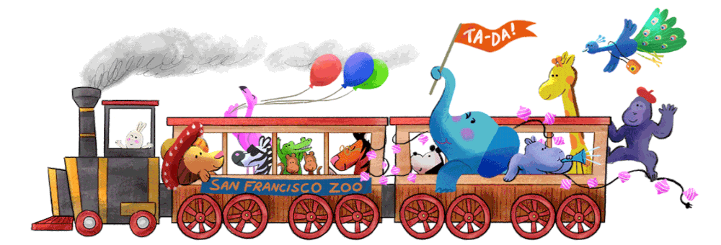
CBS EXPRESS Vol: 7 | Issue # 2
5
A Day at The Zoo
One day, my friends and I went on a field trip to the zoo. We saw all kinds of animals – Lemurs, Zebras, Cheetahs, Seals and more. My BFFs were having such an exciting time! Suddenly the elephants broke out of the cage. My friends and I made a plan. We saw a trampoline from the kids' corner and used it to jump on their backs to calm and shush them, but it did not work. They were still rampaging.
Suddenly, I saw a baby elephant all alone, and I realized that is why the elephants were rampaging. They had lost their baby, and they were looking for it. I told my BFFs, and they calmly put the baby elephant back into the cage. Next, the elephants went in too. The zookeeper gave us free tickets to the zoo movie theatre, and that is how we saved the day for everyone.
Fatmah Wael
Grade 3D
Fantastic Movie Day
Last weekend I went to the cinema at 360 Mall with my family to watch a Tom and Jerry movie. First, we booked the tickets from the cinema website. Next, we went to the mall to enter the theatre. Then, we bought popcorn, nachos, and juice. After that, the Tom and Jerry movie started, and we sat down to watch it. Finally, the movie was over, and we all felt happy because it was hilarious and full of adventures.
It was a lovely movie day that we spent together.
Homoud Abdullah
Grade 3A

Slide 6
6
CBS EXPRESS Vol: 7 | Issue # 2
Why Camels Are Cool
General Statement
Camels are mammals as which means that they have hair and they feed their babies milk. They are not aggressive animals. Camels are almost always slower than horses but sometimes they can run faster than them. They have been used for transportation since ancient times.
Appearance
Camels have long legs, big lips and humped backs to help them store food and water. Dromedary camels have one hump and Bactrian camels have two humps.
Habitat
Bactrian camels live in the Gobi Desert in China. Dromedary camels live throughout areas in North America and the Middle East. A population of Dromedary camels live in Australia.
Diet
Camels are herbivores. They eat grass, oats, wheat and grains. They are always looking for food, but it can be hard to find food in a desert environment.
Grade 5 Writing
Mariam Ahmad Gr 5B-B
Camels
General Statement
Camels are mammals that can go a long time without water. In ancient days, many people used camels to travel to places.
Appearance
Camels have long legs, a big lipped snout and humped backs. There are two types of camels which are the Dromedary and Bactrian camels. Dromedary camels have one hump on their back while the Bactrian camels have two. Camels’ fur colour can be light brown or greyish.
Habitat
Camels are mostly found in hot places like deserts, prairie and steppe. They can also survive in cold places.
Diet
Camels are herbivores. Most of the food eat is grass, grains, wheat, and oats. They can spend days searching for food. Food can be hard for them to find in their environment.
Abdullah Issa Gr 5B-A

Slide 7
7
Camels
General Statement
Camels can live up to 40 years. Scientists call them “camelus”. They surprisingly sleep while they’re standing. This is a way to protect them by making the predator think that they’re awake.
Appearance
Camels have one or two humps on their backs to store their food. They also have long legs so that it is easy to walk on the very hot sand. Camels also have a very short tail that is hard to see because they have so much fur.
Habitat
All types of camel love in the desert. Some live in the Middle East, some live in Asia, but it has been proven that Australia has the most camels in the world. And they can go up to 7 months without water.
Diet
Camels are herbivores, eating grass, grains, wheat, and oats. They can also eat hay. Their favourite foods are fish, bones and oats but these are sometimes too nutritional for camels.
CBS EXPRESS Vol: 7 | Issue # 2
pot the difference
Mohammad Ahmad S. Gr 5A-B
Camels Are Cool And Interesting
General Statement
Camels are mammals and they can live for forty years. They are very friendly and intelligent animals. A group of camels is called a caravan. They are known for transporting people. Camels cannot swim.
Appearance
Camels have long legs and a short tail. The hump on their backs store fat. They are about 400 to 600 kilograms and can reach a height of 1.8 to 2 meters. They have big, wide feet to walk on sand and a very strong jaw.
Habitat
Camels live in the Gobi Desert in China and the Bactrian Steppes of Mongolia. The countries they are found in are Turkmenistan, Oman, Tunisia, China, Saudi Arabia, Nigeria, Yemen, UAE, India, Afghanistan. Mongolia, Eritrea and Mali.
Diet
Camels are herbivores. They eat grass, grains, wheat, and oats. Sometimes they eat carrots, red beets or mangolds. They drink twenty gallons of water at a time.
Hessah Aref Gr 5A-A

Slide 8

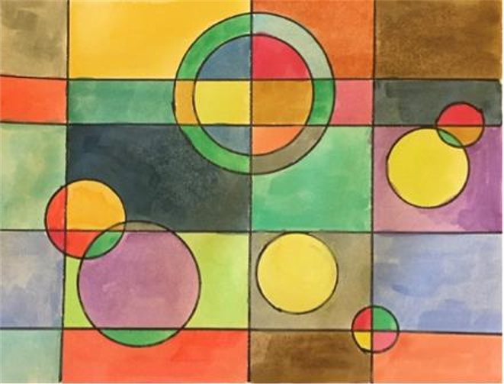


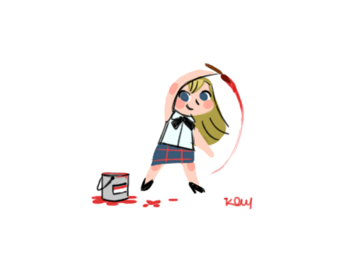
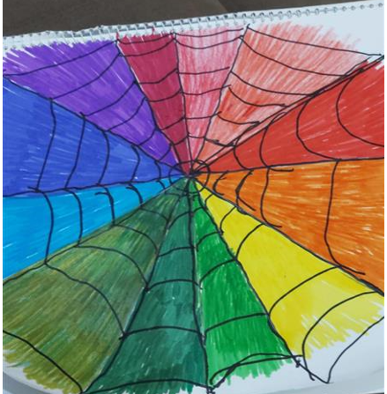

CBS EXPRESS Vol: 7 | Issue # 2
8
Art Corner
Abdulrahmand Ibrahim
Gr 8A-A
Abdulwahab Adnan
Gr 8A-B
Ahmed Yousef
Gr 6B-A

Slide 9
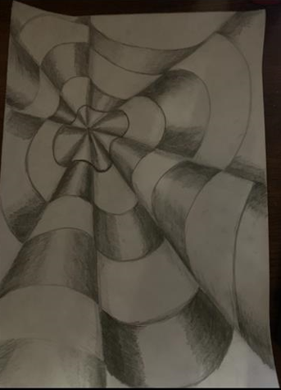
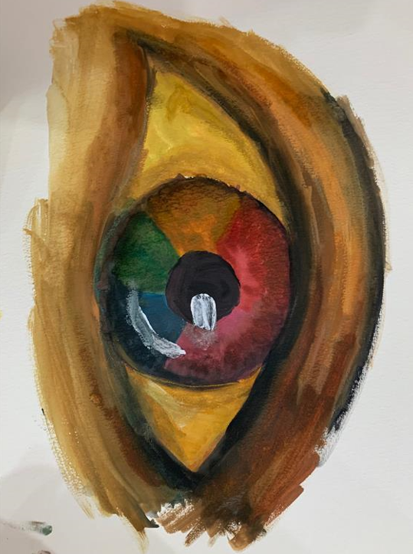



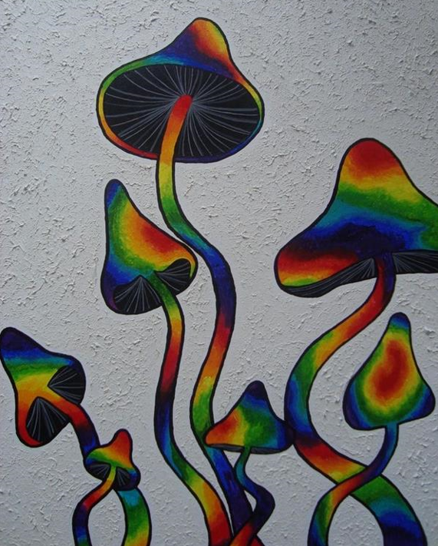


Art Corner
9
CBS EXPRESS Vol: 7 | Issue # 2
Fatima Yaqoub
Gr 6A-A
Homoud Nouri
Gr 12A
Manar Naser
Gr 12A
Shams
Gr 6A-a

Slide 10
CBS EXPRESS Vol: 7 | Issue # 2
10
Grade 7 Writing
Dear Miss Meriam,
Although I have thoroughly enjoyed my past years in my school experience thus far, there is one constantly prying issue that I feel I must discuss: homework.
Yes, I know it is a constant battle between students and teachers every year. However, I firmly believe my complaint is justified. It is not homework itself that is the problem; I often find homework help in learning current information and preparing for a test. However, it is the amount of homework that has compelled me to speak out. Every night and weekend, I am constantly barraged with a steady stream of assignments and projects that have overwhelmed me and forced me to speak out against them. I plead that you will listen to my opinion and stop assigning so much homework.
Homework often gives me no choice but to devote each weekday afternoon to school and little else. Although homework is necessary to help students learn and understand the material, there is no justification to assign hours of homework every night. I come home from school every weekday, sit down, and complete two or more hours of homework and studying. Afterwards, I have time for dinner, a shower, and a little time with my family to read or watch television, and then I go to sleep! It is a constant cycle Sunday through Thursday. Even on the weekends, I can usually expect at least a couple of hours of work, if not more. It is hard to appreciate a weekend when Sunday is constantly devoted to studying and completing assignments. This workload means I have almost no time for personal activities.
I love to bake, cook, and write short stories. However, unfortunately, I have no space to squeeze these hobbies in during the week because I am so overloaded with school task completion.
Dhai Mohannad
Gr 7A-A

Slide 11
CBS EXPRESS Vol: 7 | Issue # 2
11
Grade 7 Writing
Is online learning better than in-person learning?
In-person learning is better because you can play with friends and have fun with them. You can learn faster, improve your academic knowledge, and be more competent; it is less distracting. It is better because you get to be with your friends, play and do the task together. You enjoy coming to school and because you are happy you pay attention in class and get good marks in exams.
Secondly, you can learn faster by focusing on what is being taught in the class and paying attention to the teacher. You understand better when the teacher is in the class, as you can ask questions and get answers faster.
Finally, there is no distraction in school because you are not in your home and nobody to disturb you. Your sibling cannot fight with you, and you do not waste time with them and miss what is going on in the class.
In conclusion, we are happier, make more friends, and get good marks in exams.
Saif Mishaal
Gr 7B-B

Slide 12
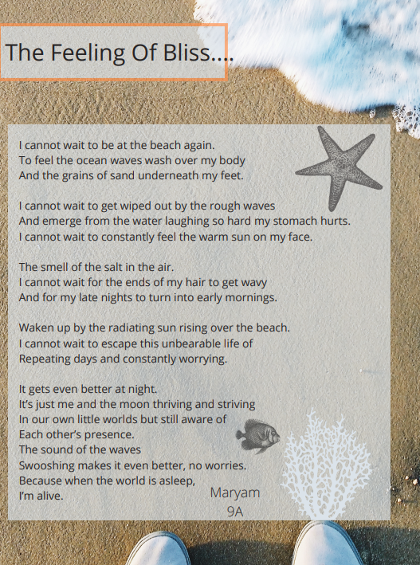
12
CBS EXPRESS Vol: 7 | Issue # 2
Grade 9 Writing
Maryam Ali Gr 9A

Slide 13
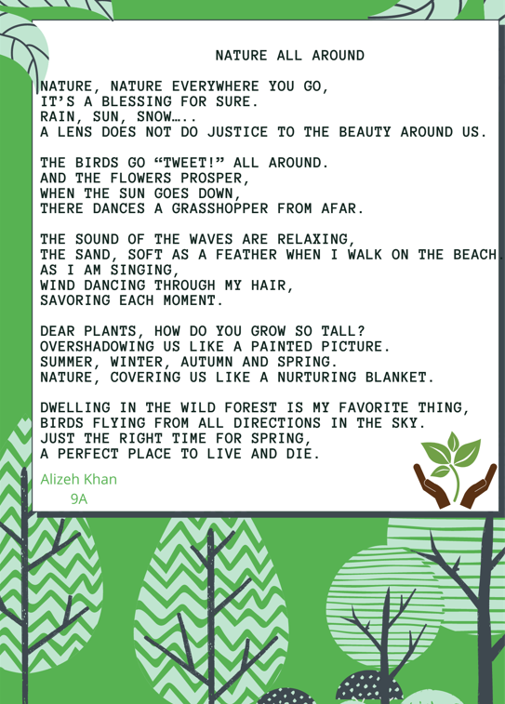
CBS EXPRESS Vol: 7 | Issue # 2
13
Grade 9 Writing
Alizeh Khan Gr 9A

Slide 14
14
CBS EXPRESS Vol: 7 | Issue # 2
Grade 11 Writing
Poppins and the Jewel
Once on a bright sunny day, Poppins, a 13-year-old boy, short and handsome, woke up and got ready for school just like any typical day. He lived in a small, poor town in the west of Virginia. As he was getting ready, his mom came in with a sad look on her face. "What is wrong," he asked, "are you okay mom, is there something bothering you?" His mom put her hand on his shoulder and told him, "Your uncle passed away this morning; I know it is sad, and you were very close to him, but he is in a better place now."
Poppins got incredibly sad because he was not a social butterfly did not have many friends. He only had his uncle and two friends Alex and Mia. In the afternoon, Poppins heard a weird knock on the door. He ran to open it, but no one was there except a box on the floor with his name. Poppins, by his nature, was a timid and scared boy who never got out of his comfort zone. He wanted to cry with fear because no one was home. However, he gathered courage, took the box, slammed the door, went right up to his room, and hid under the sheets. Hours went by until his mother came home and asked him, "what is wrong? Are you okay? Did something happen?" With a shaky voice, he told her what had happened. "Well, let us go and open up the box," she said.
Poppins, under his mother's watchful eye, opened the box. "Mom, it is just my uncle's diary and a weird container with some jewel in it. Can you look?" he said. His mom's jaw fell on the floor when she saw the jewel in the container.
"OH MY GOD!" exclaimed the mother. "What is it? What is wrong, mom? Should I have not touched it? mom tell me to answer me; what is it?" "Okay, okay, calm down, nothing is wrong with it. I was just super surprised when I saw it." "Why? he asked. "Well, Poppins, one day, your uncle and I went on a hiking trip until we saw a small cave. He snooped around and found this jewel inside. Now I do not know that much about it, but from what I know, it is not a normal Jewel, and Uncle kept saying, "I SHALL FIND WHAT IT HOLDS, I SHALL FIND WHAT IT HOLDS" repeatedly. Once we asked him about it, he said that it was very precious to him, and we should be careful around it.
The next day he went to school and told his friend about it. However, they did not do anything about it. Weeks went by, and Poppins left it in the same box in the same place and did not touch it. He hid it under the cabinet and went to bed. He heard whispers calling his name "Poppins", and the voices were starting to get louder. Suddenly, he got the urge to grab the jewel and get out of the house. So, he grabbed the jewel, put it around his neck and started running to his friends Alex and Mia's house. "We need to go now; I will explain everything later. Just follow me," said Poppins. So, they started following him on a bicycle. "Slow down. We cannot keep up!" Alex yelled. Nevertheless, Poppins ran without stopping as though he possessed some supernatural powers. Then he stopped next to a huge tree that had a secret passageway behind it.

Slide 15
Grade 11 Writing cont’d
15
CBS EXPRESS Vol: 7 | Issue # 2
"What is happening, dude? How did you know about this passageway? Tell us WHAT IS GOING ON, BRO! How are you this fast?" Alex and Mia kept storming with their questions in bewilderment. "Does it look like I know; I am just as shocked as you are, guys. Now please help me stop the whispers. I am going mad." answered Poppins. Mia and Alex looked at each other, knowing that it was all too weird.
The three of them went down the passageway using a makeshift staircase with flashlights to guide them in the dark. "Listen to me; we have to stick together and stay close." Poppins said fearfully. "Do not worry, bro, and we will stick together, and we got you. So, from what I know and read in my uncle's journal that we should continue straight and break the jewel in half when we find the secret door." Poppins explained. Suddenly, a vast rock slid and almost crushed them, but just in time, Poppins stopped it casually with his hand as they were walking. "Cool, you are like a superman," Mia said with excitement in her voice. "This passageway is not good news. Do you hear those voices? God, you got into some trouble, Poppins". They kept talking until they heard some weird noises that had made them all scared. It was some creature walking like a zombie. Mia and Alex ran as soon as they saw it so did Poppins. "Why are YOU running away? You are the one that is supposed to have him; you are the one that has super strength. Do not be a scaredy cat." Mia pushed him towards the zombie.
Poppins grabbed his pocketknife and started stabbing the zombie. He pulled him from his neck and slashed it. "Honestly, we are not surprised anymore; there is nothing that you cannot do! Excellent job, bro; you saved us." he said. Every 100 steps they took, they became weaker, and more creatures would show up. However, with Poppins' newfound superpowers, and Mia and Alex's help, they got closer to the secret door. After walking for many hours, they finally found the door. Poppins broke the jewel in half and put it in a socket for it.
As soon as the jewel broke, the floor started to tremble, and the rocks were breaking. It seemed like an earthquake. Suddenly the door opened wide, and a bright light shone through them. "Guys, cover your eyes with your hands and start running. I will guide you." Poppins said. "Guys, you can open your eyes now. Look, look at all this gold, money, and pearls. WOW! this is Crazy."
There were piles and piles of gold and money until they heard footsteps. Poppin's uncle came out to everyone's disbelief and said, "well, Poppins, guess who is the hero now - you are!". Also, you are the only one that can see me because we are related. I am just a ghost, but I am here to congratulate you. You have grown so much, and you saved your friends and your town. His uncle whispered in his ears, "now listen to me close; you keep the second half for your kid and guide him every step of the way and tell him what to do." After he was done, Poppins wanted to hug him, but then his uncle just vanished. All three of the kids got as many goods as possible and gave them to the townspeople who needed them. Their story was written and published everywhere. Everybody was super proud of them. Poppins saved the second half for his kid and wrote in a journal everything that happened, every weapon he used, every power he had possessed. Thirty years later, Poppins narrated the story to his grandkids and gave them half of the jewels.
Shoug Hussain Gr 11A

Slide 16
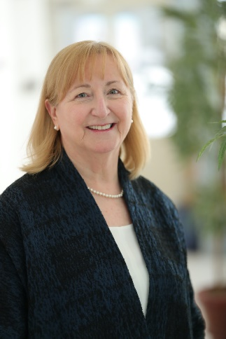

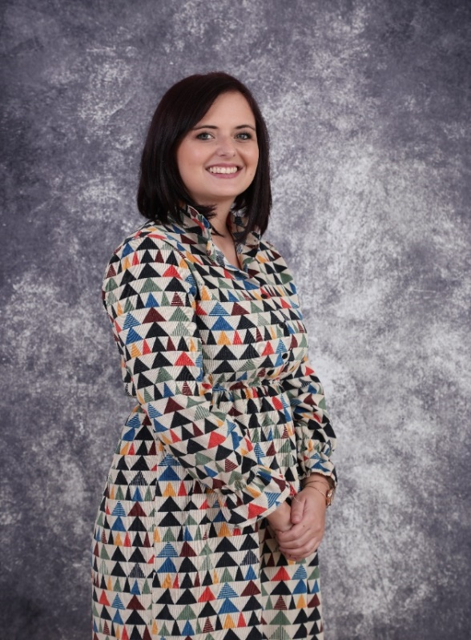
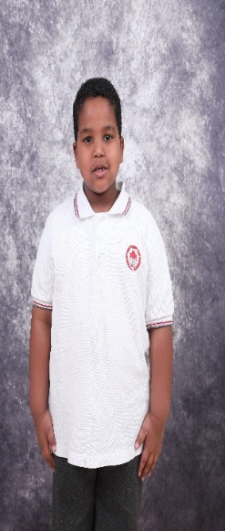
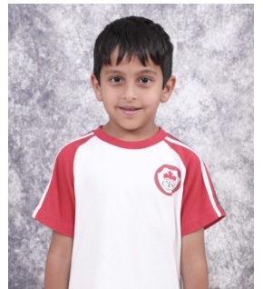
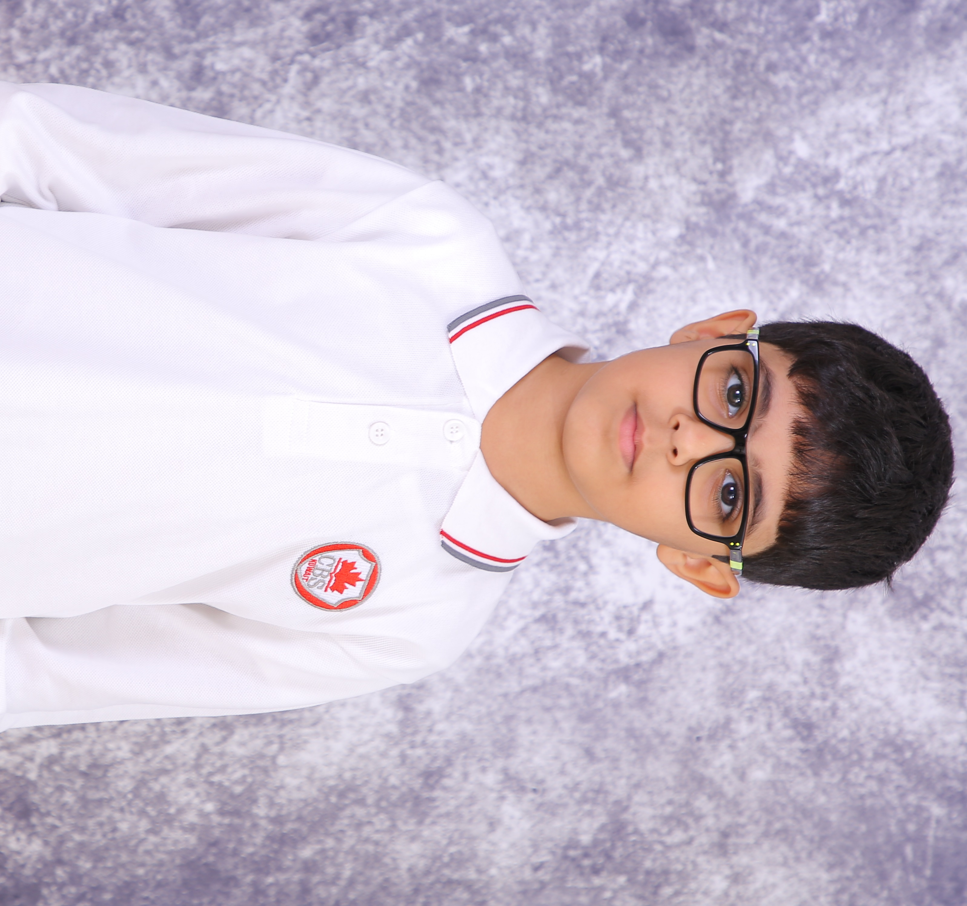
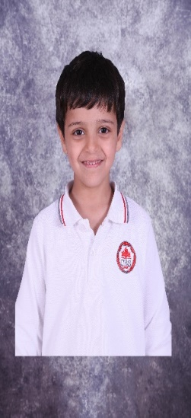
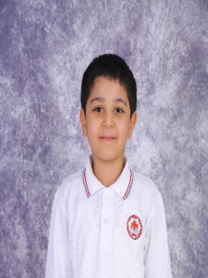
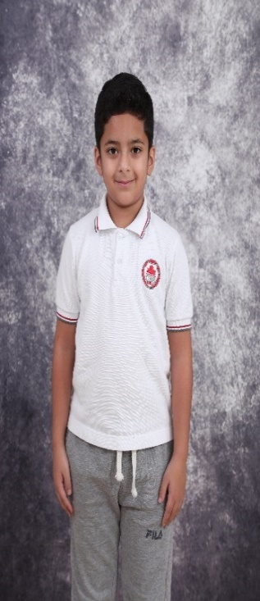
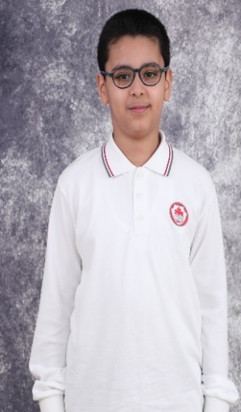

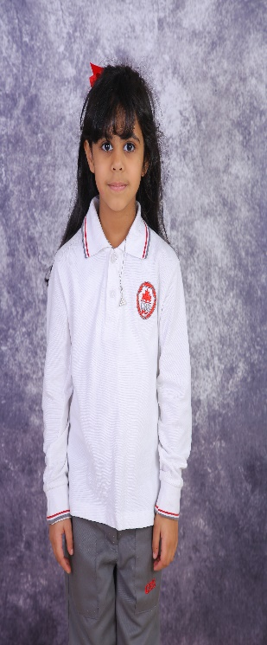
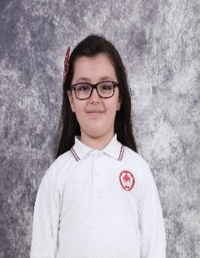
CBS EXPRESS Vol: 7 | Issue # 2
16
Dr. Mary Kelly
Principal
Ms. Maryke
ES SC Coordinator
Student Council
ES Student Council
                Mohammad Khaled
Salman Dawoud
Abdullah Salem
Bani Bnayan
Ahmad Anwar
Othman Yousef
Muddhi Thamer
Shahad Hamad
Fatma Wael
Ajna Ilir

Slide 17
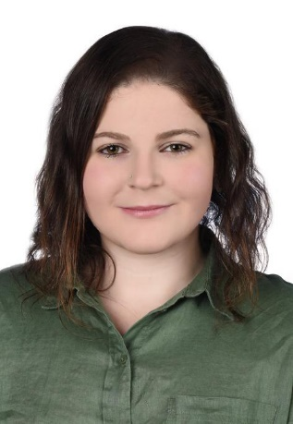
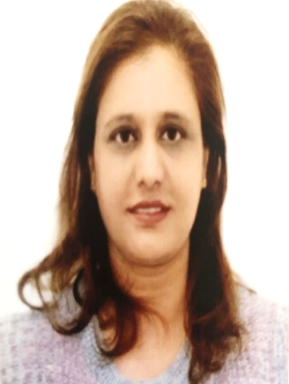
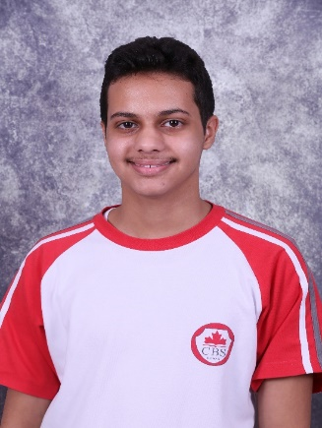
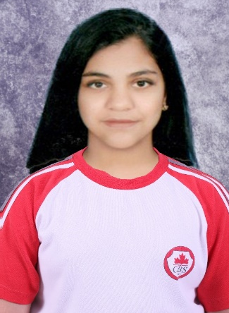
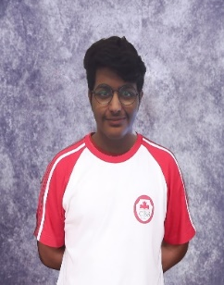
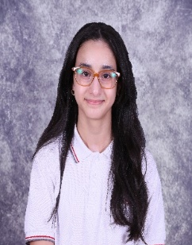
CBS EXPRESS Vol: 7| Issue # 2
17
HS STUDENT COUNCIL
Student Council Coordinators
Ms. Zeina El Amin
Gr 9 - 12
Ms. Tasneem Dalal
Gr 6 - 8
Head Boy
Head Girl
Talal Zaid
Manar Naser
Deputy
Head Boy
Deputy
Head Girl
Ali Naser
Feely Faisal

Slide 18
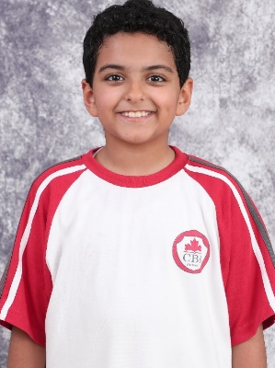
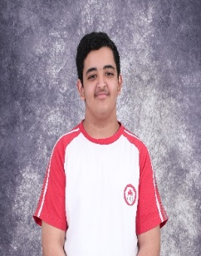
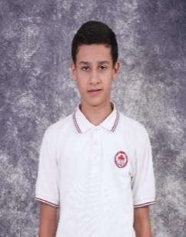
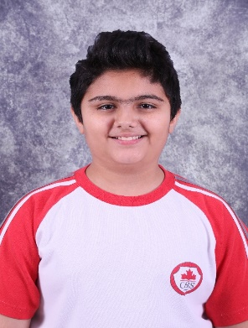
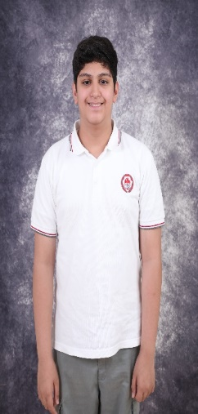
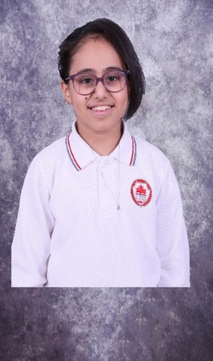
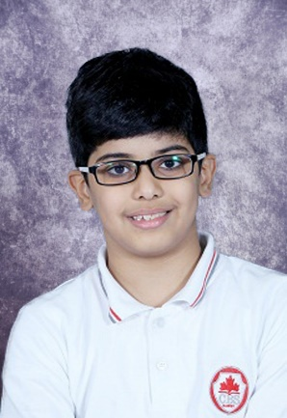
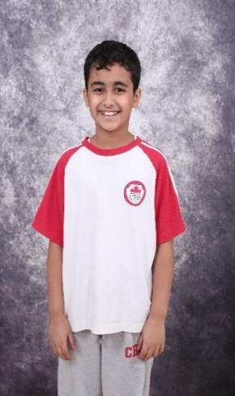





CBS EXPRESS Vol: 7| Issue # 2
18
HS STUDENT COUNCIL Cont’d
Abdulaziz Mohammad
Khaled Fahad
Mohammed Salah
Naser Ahmad
Abdullah Fadhel
Asmaa Yousef
Abdulaziz Mubarak
Abdulaziz
Faisal
Abdullah Sulaiman
Sami Khalifah
Nayef Talal
Abdul Wahab Khaled
Khalid Ahmed

Slide 19










Puzzle TIME
19
CBS EXPRESS Vol: 7 | Issue # 2
pot the difference

Slide 20




CBS EXPRESS Vol: 7 | Issue # 2
20
UPCOMING EVENTS at CBS
Reading Month- Nov 1st –Nov 30th
Report Cards go Home - Nov 4th
Book Fair – Nov 7th – Nov11th
Parent Conference Week – Nov 7th – Nov 11th
SK Healthy Living: Fruits Day- Nov 14th
MSA Reaccreditation Team Visit- Nov 15th- Nov 18th
International Day- Nov 18th
International University Fair (Gr 11-12) – Nov 18th
Photo Day- Nov 21st- Nov 25th
After school clubs End (Every Wednesday Oct 13 - Nov 24)
Orange day (JK - GR 2)-Nov 25th
Assembly : Kindness (2A,2D) Kindness play- Nov 25th
Gr 8 Healthy Living – Teamwork Nov 25th
Reading Month Results- Nov 25th
Healthy Lunch Audits- Nov 28th - Dec 2nd
Gr 3 Parent Engagement Event / Litpro Orientation Nov 29th
HS Course Selection Parent Workshop (Gr10-11) Nov 29th
CBS EXPRESS Editor in-Chief: Ms. Kirti. S
The First English Language Newspaper @ CBS Editor: Ms. Monique

